Slide 1
Creating Snapshots

Slide 2
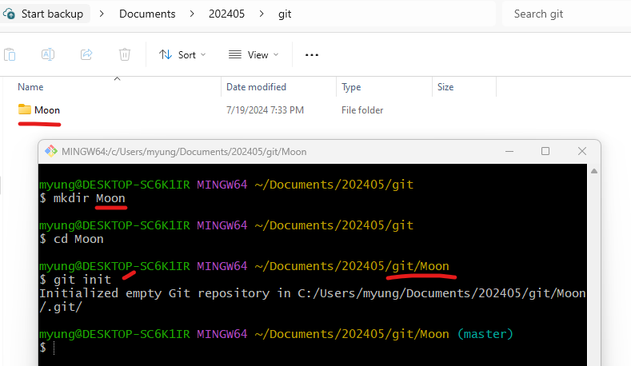
Initializing a Repository

Slide 3
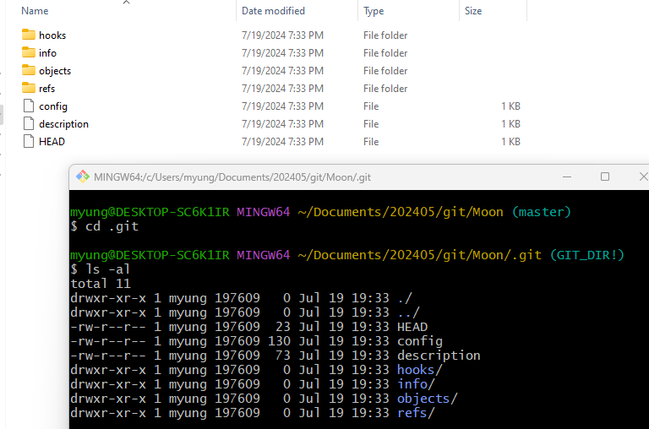
.git folder

Slide 4
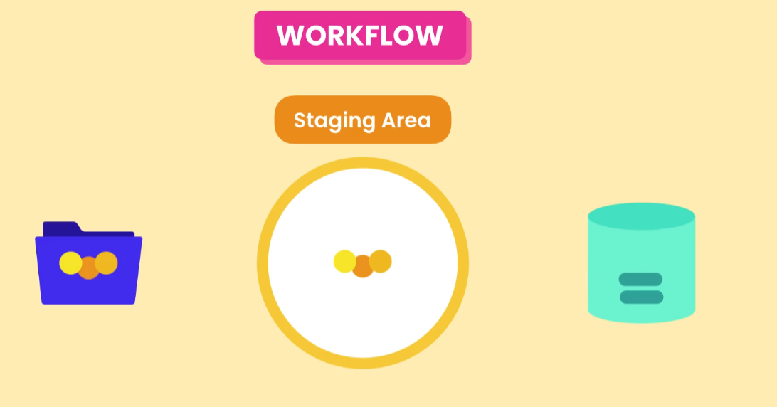
Git Workflow

Slide 5
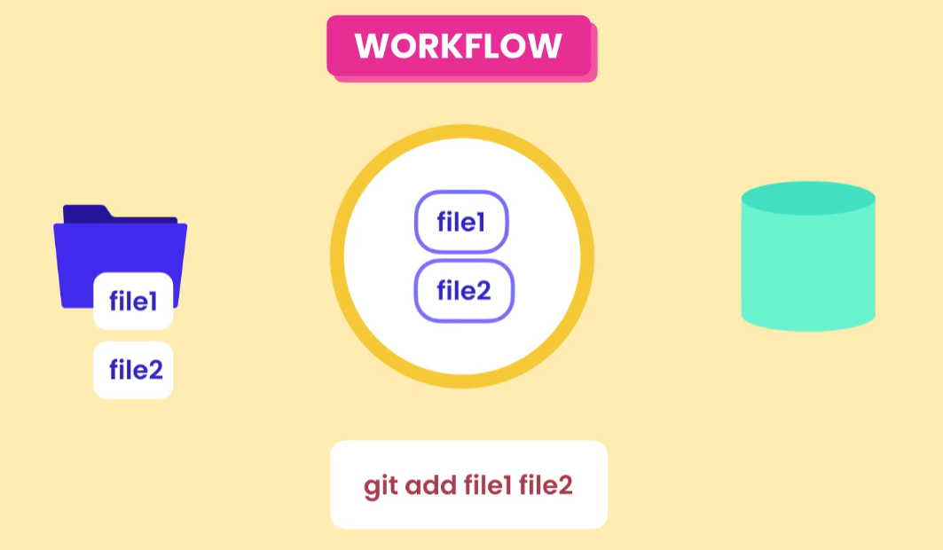

Slide 6
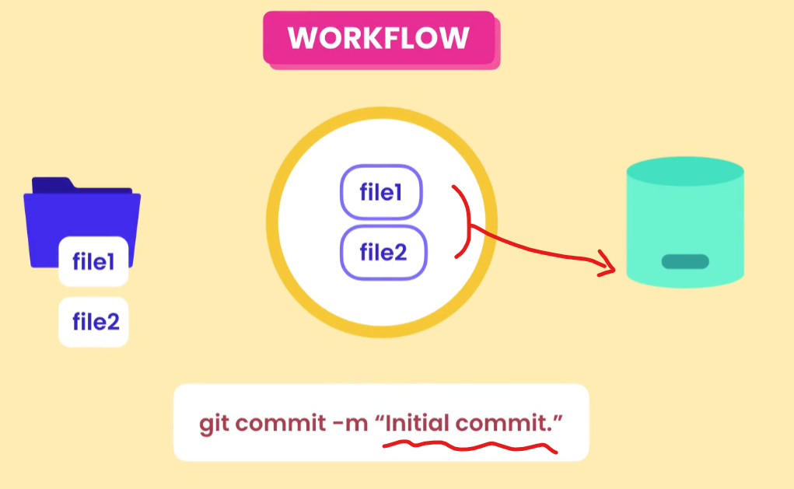
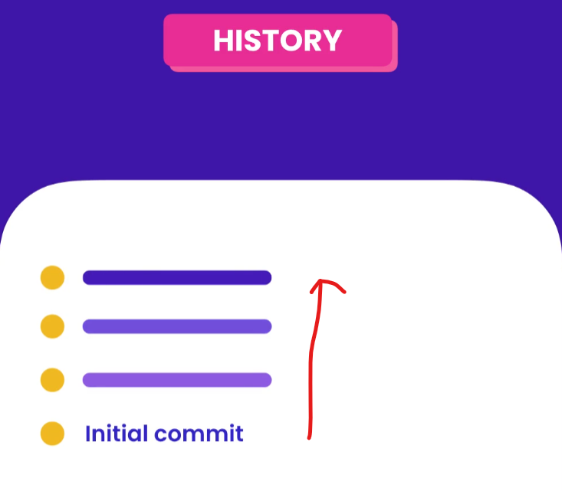

Slide 7
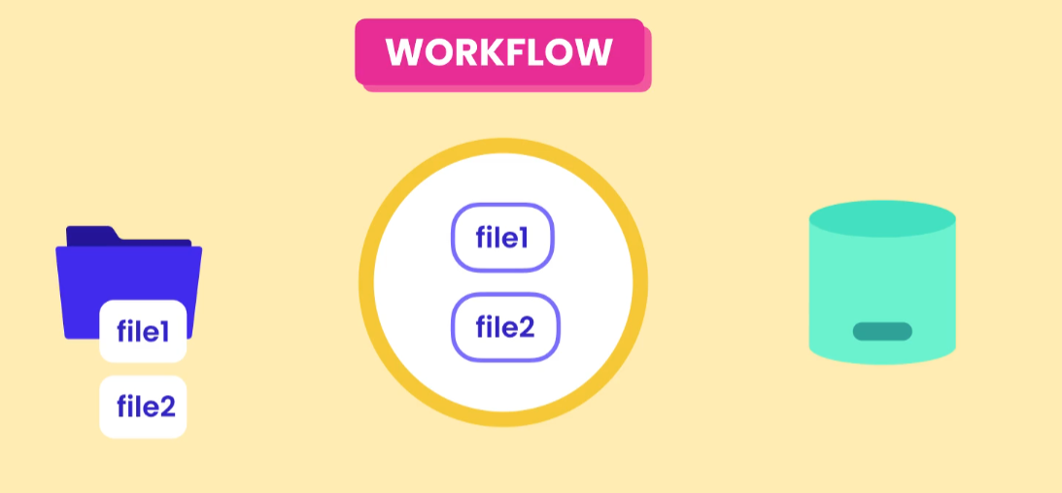
After commit, the staging area has the current same snapshot stored in the repository.

Slide 8
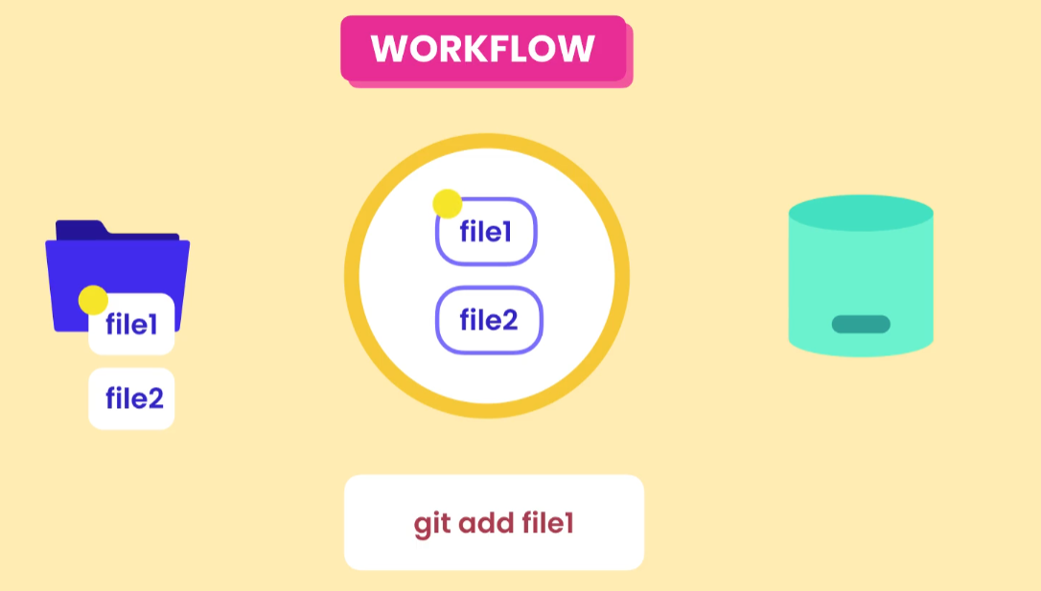

Slide 9
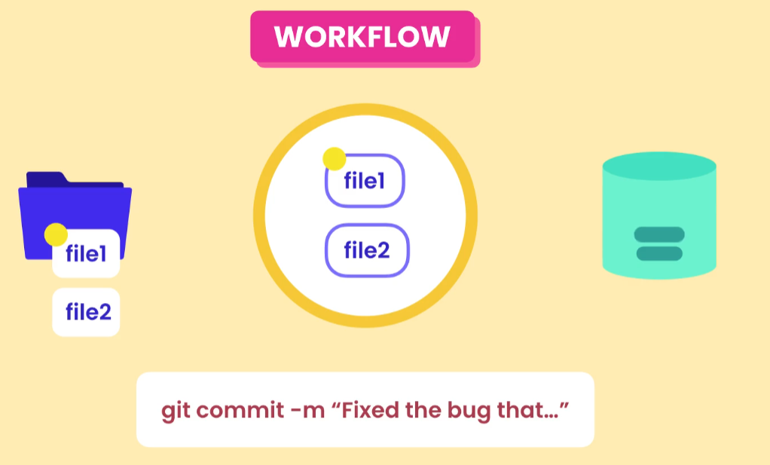

Slide 10
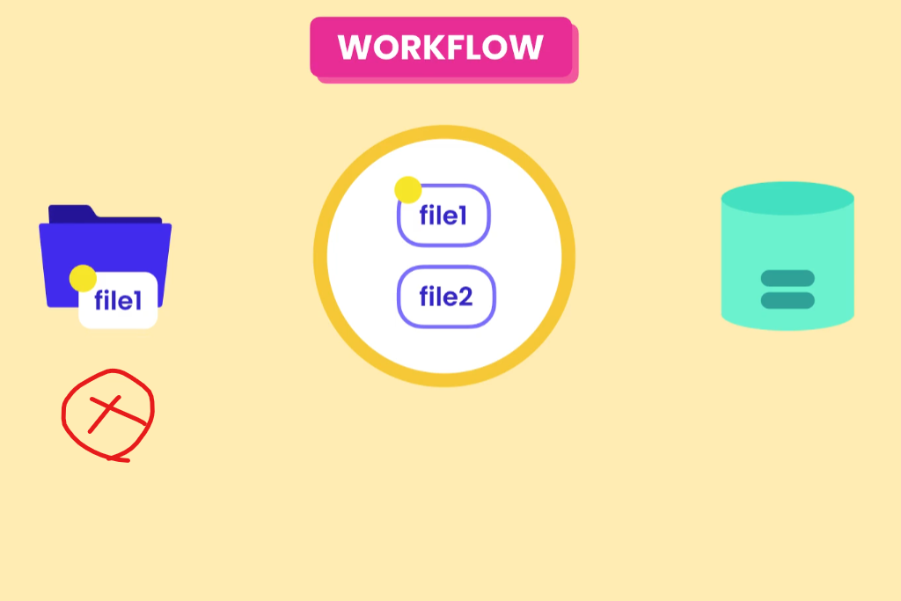

Slide 11
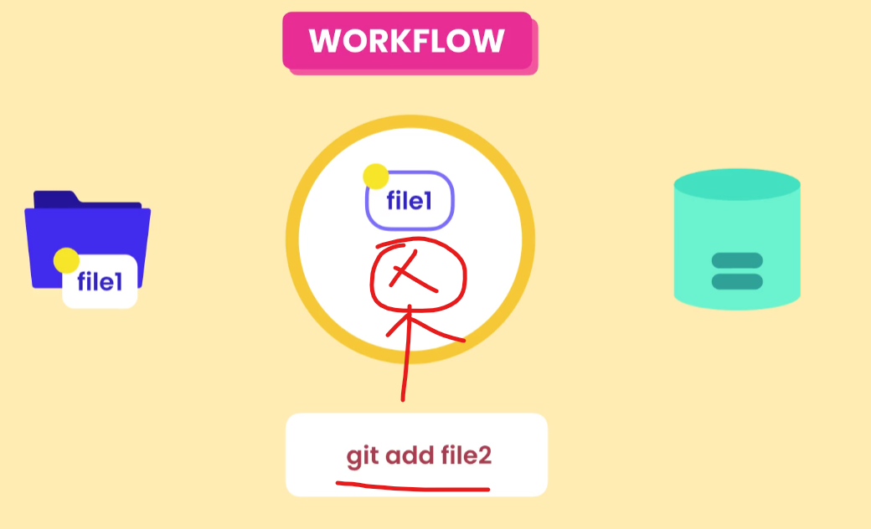

Slide 12
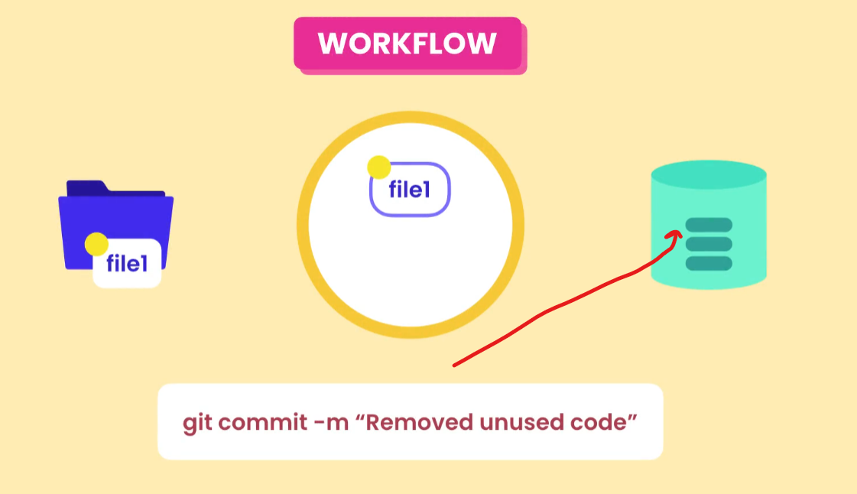

Slide 13
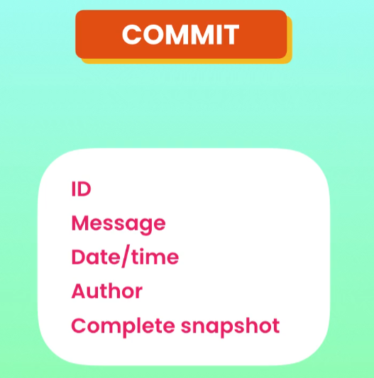


Slide 14
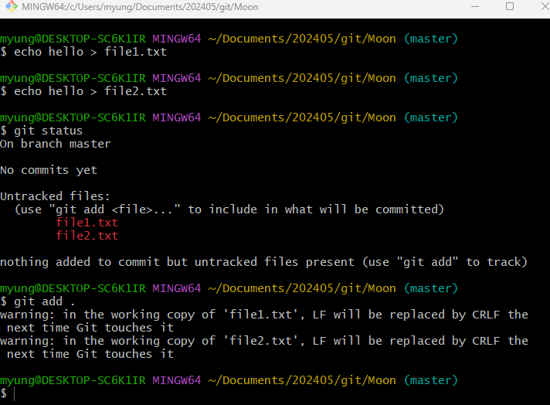
Staging Files
> git add file1.txt file2.txt
> git add .txt
> git add .

Slide 15
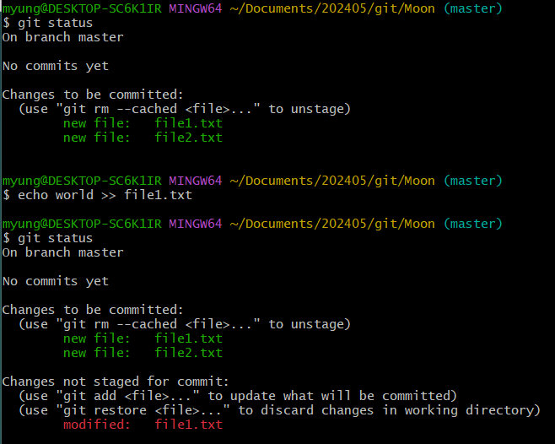
Modify file1.txt

Slide 16
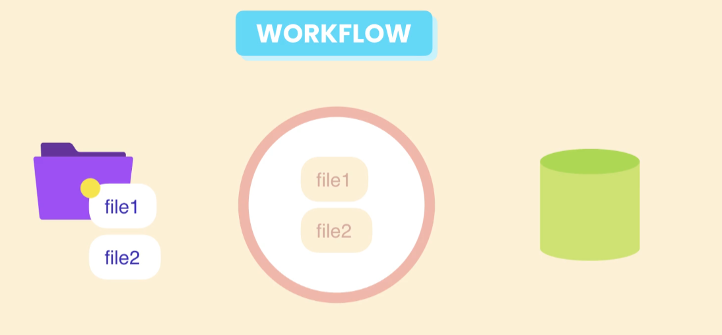

Slide 17
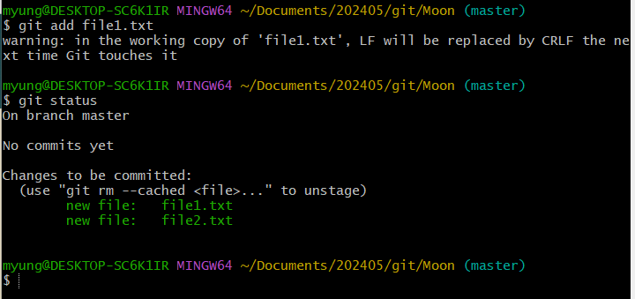

Slide 18
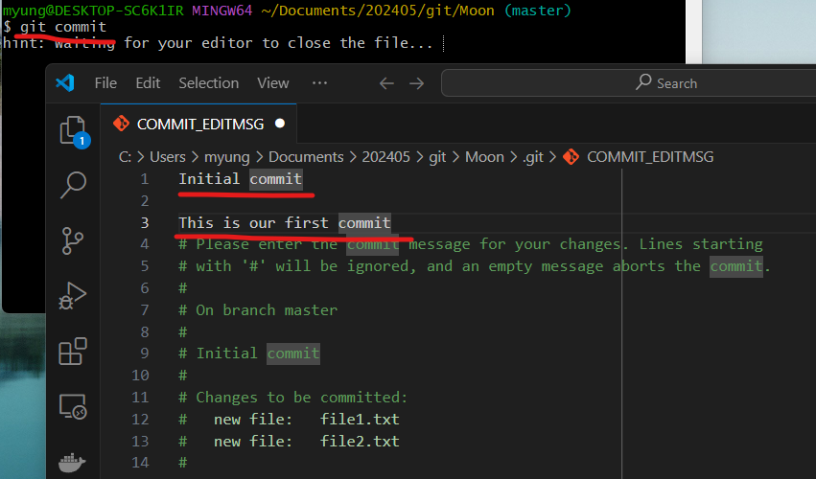
Committing Changes

Slide 19
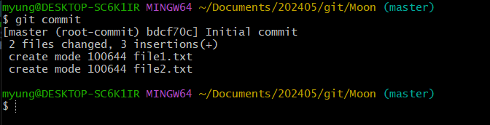
After saving the changes and closing the editor

Slide 20
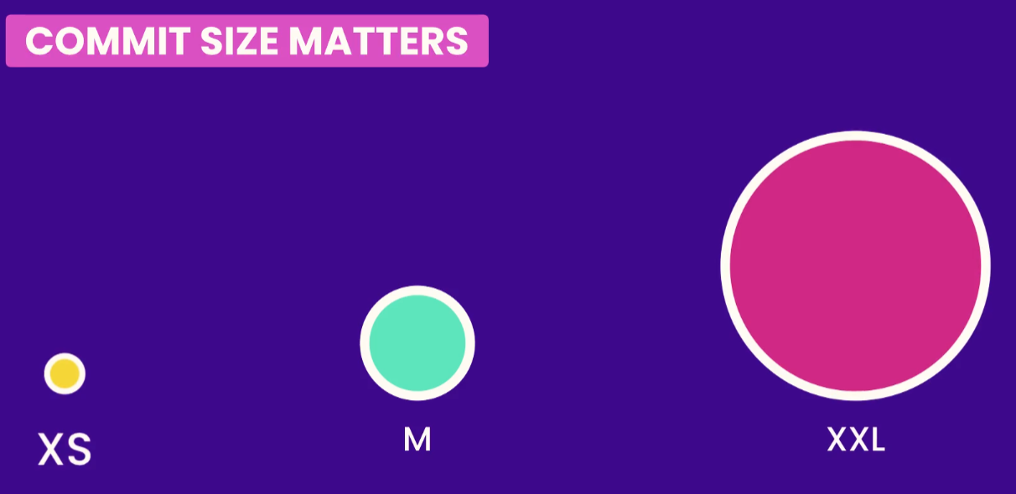
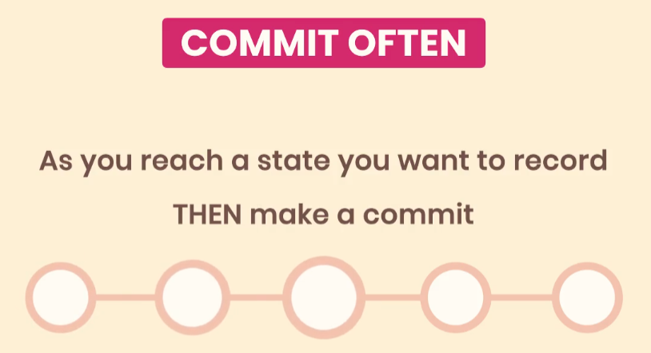
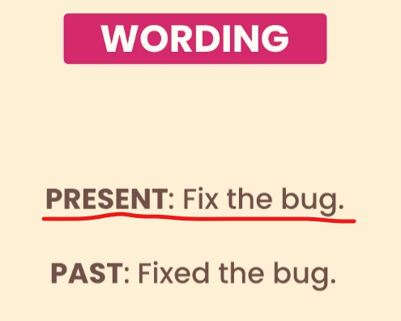
Committing Best Practices

Slide 21
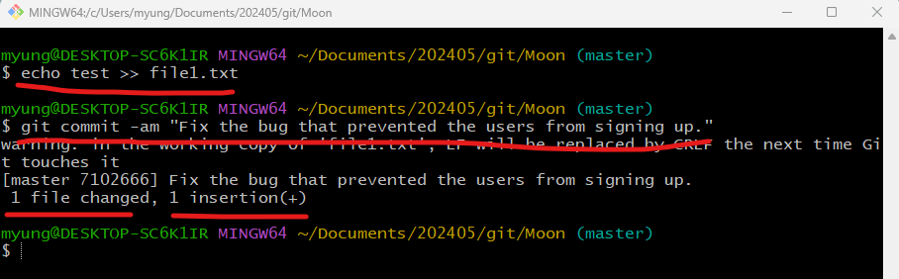
Skipping the Staging Area

Slide 22
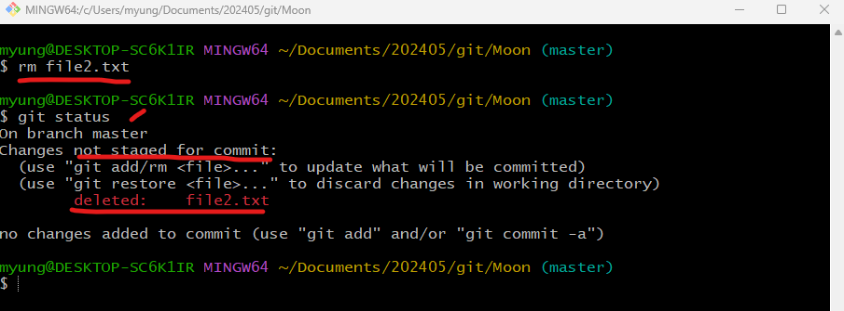
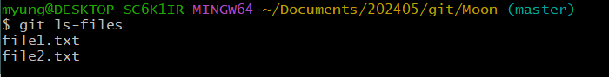
Removing Files
Why are they still there (staging area)?

Slide 23
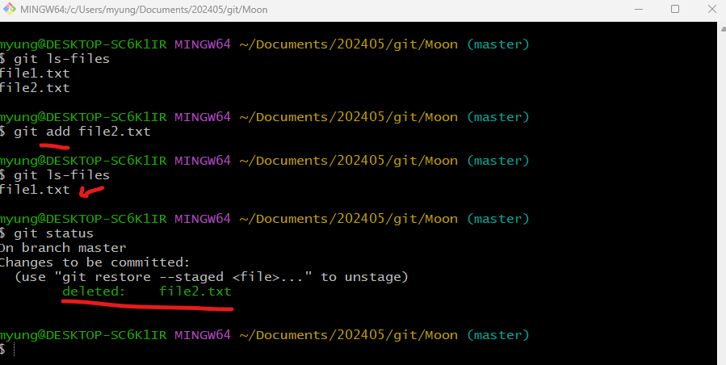

Slide 24
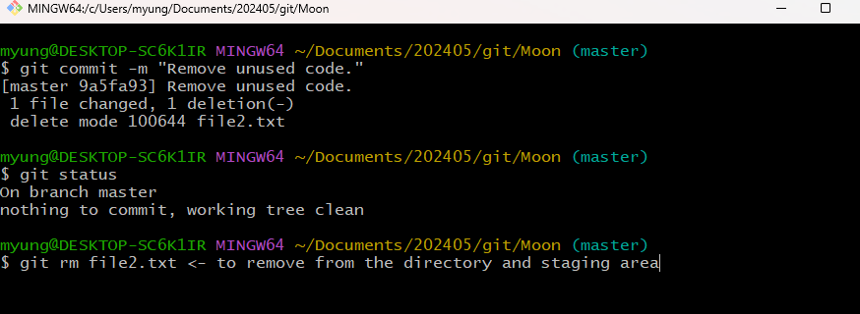

Slide 25
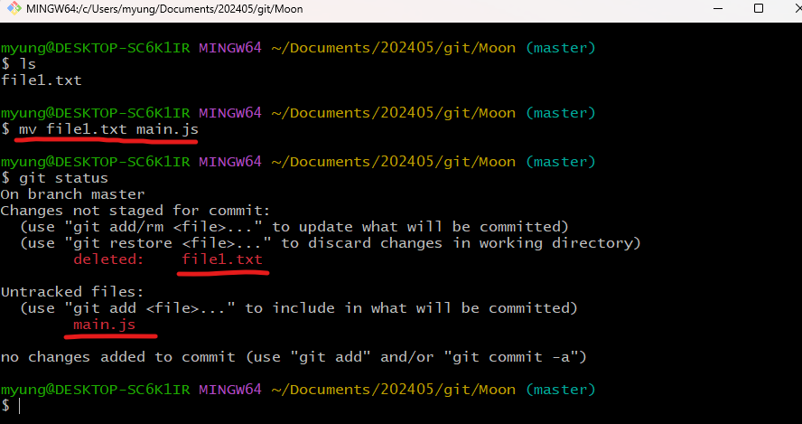
Renaming and Moving Files

Slide 26
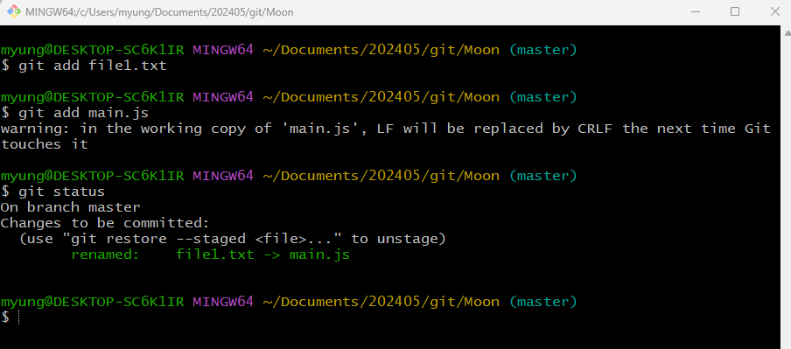
Two steps (addition and deletion)of operations are needed.

Slide 27
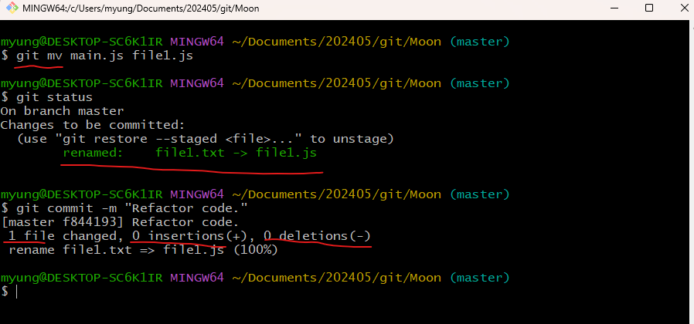
Using git mv

Slide 28
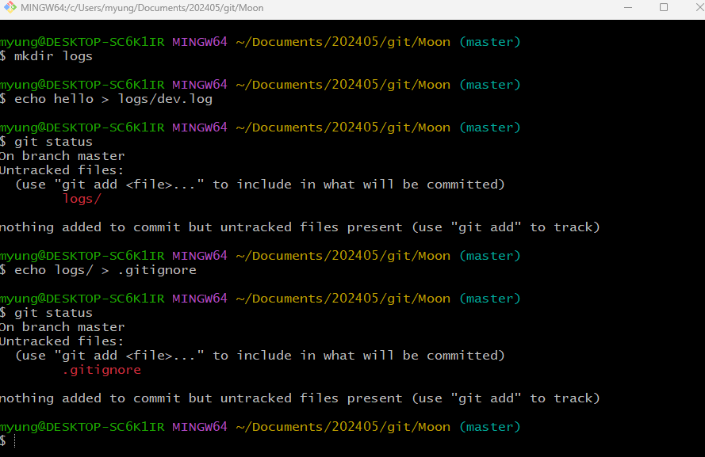
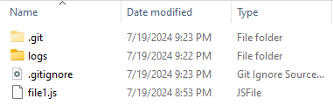
Ignoring Files - .gitignore

Slide 29
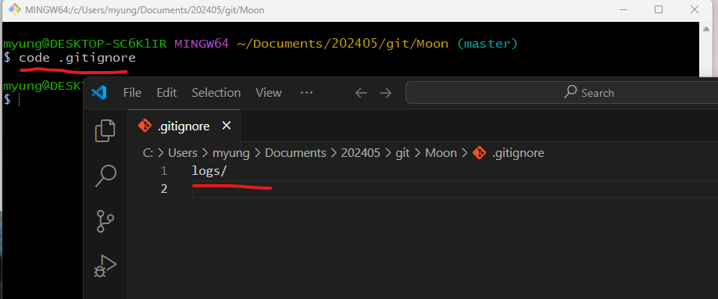

Slide 30
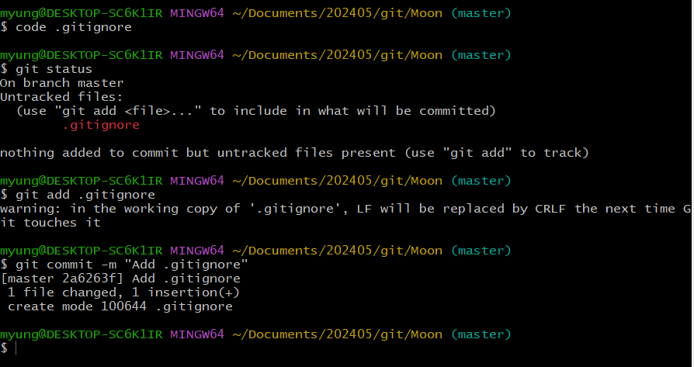

Slide 31
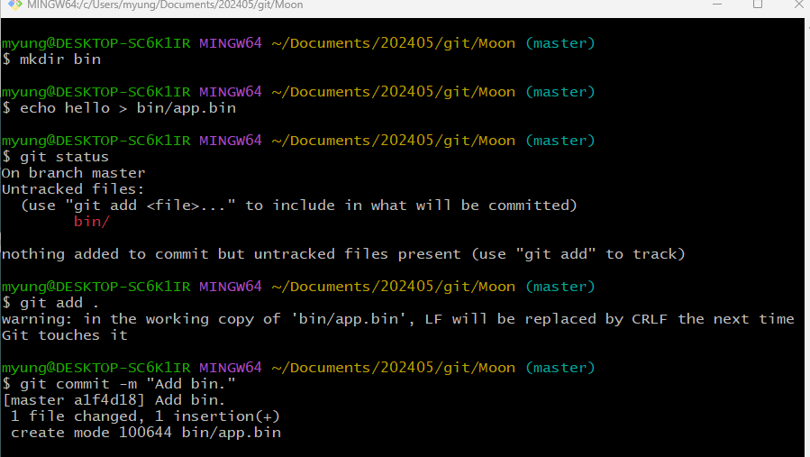
How to Handle Accidently Committed Changes
This file will be changed whenever the program is compiled or built.

Slide 32
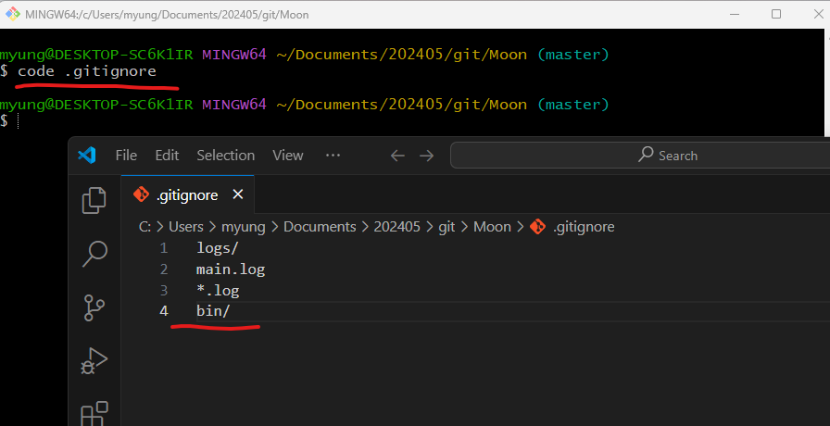

Slide 33
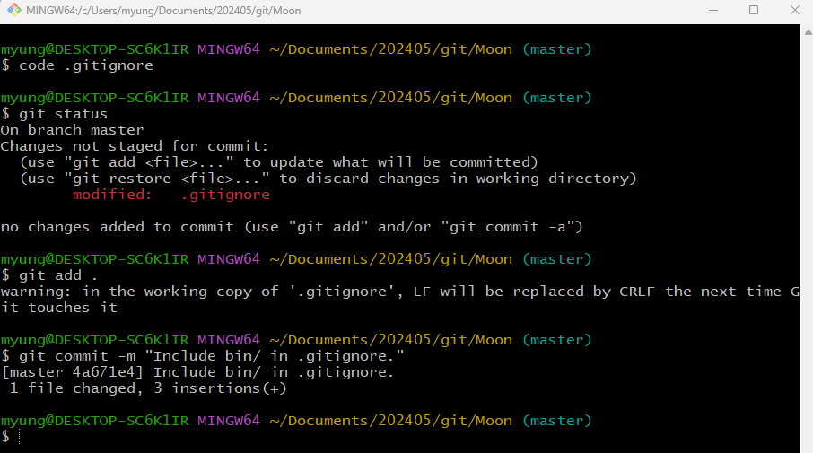

Slide 34
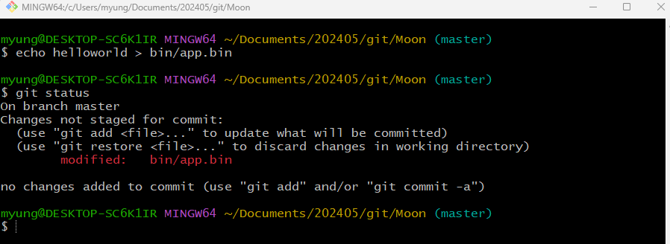
The bin/app.bin file will remain in the repository, so any modification to the file will continue to be tracked.

Slide 35
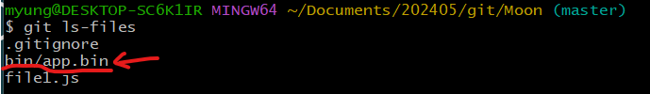
Check files in Staging Area

Slide 36
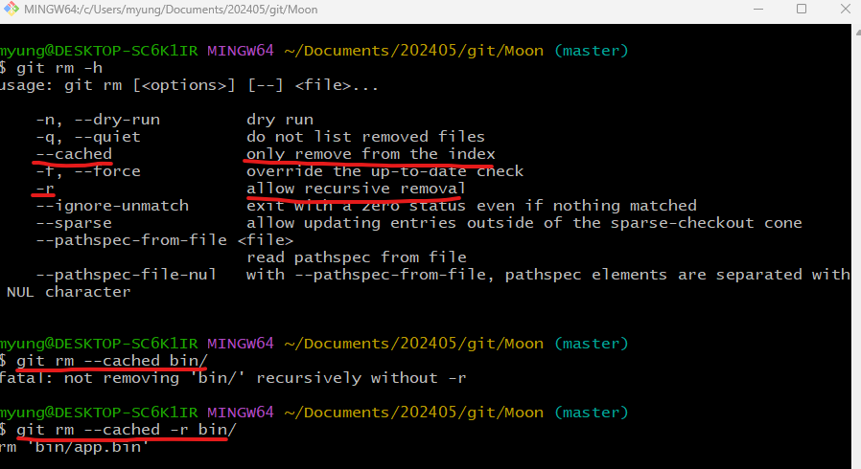
To remove the file from staging area

Slide 37
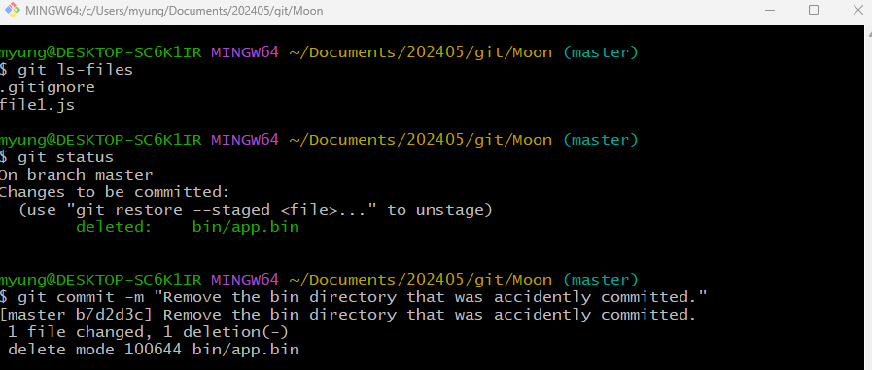
From this moment, the bin directory will be no longer tracked.

Slide 38
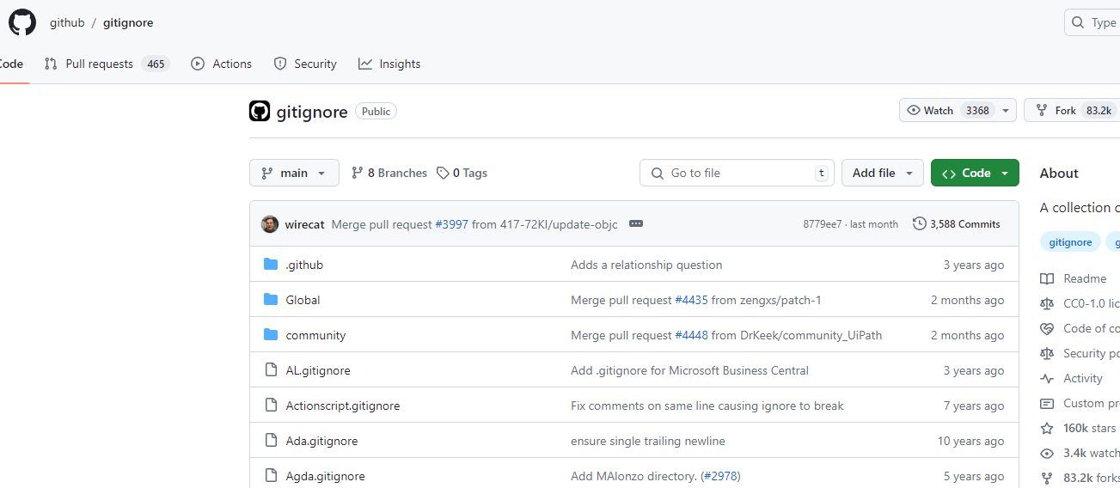
.gitignore template
https://github.com/github/gitignore

Slide 39
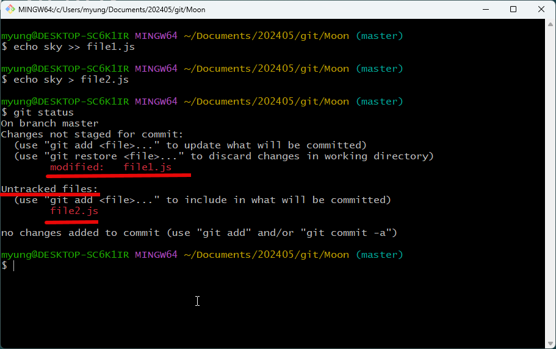
Short Status

Slide 40
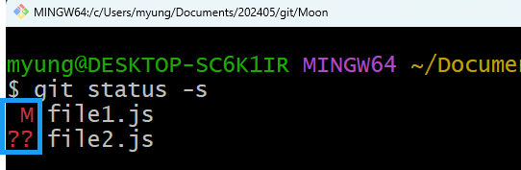
Left Col: Staging Area
Right Col: Working Directory
M: file1.js was modified, but not in the staging area.
? ?: file2.js was newly created and not in the staging area.

Slide 41
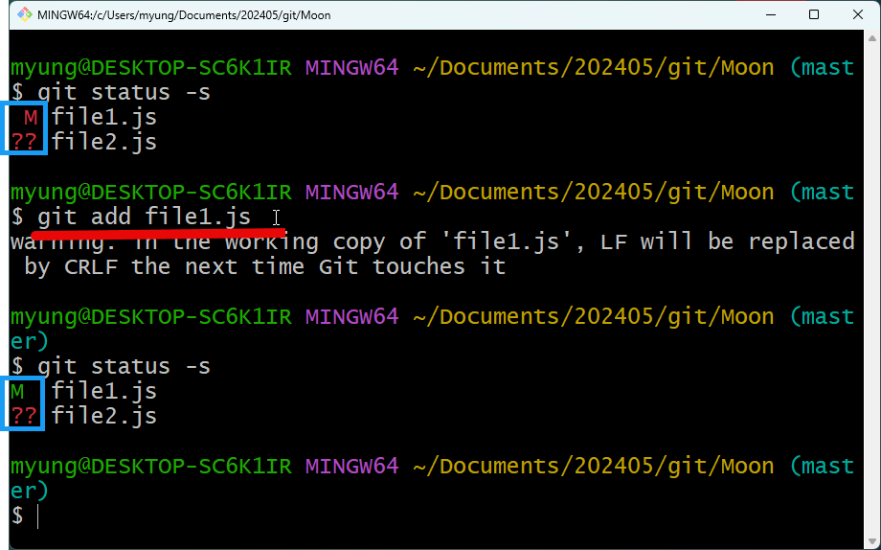

Slide 42
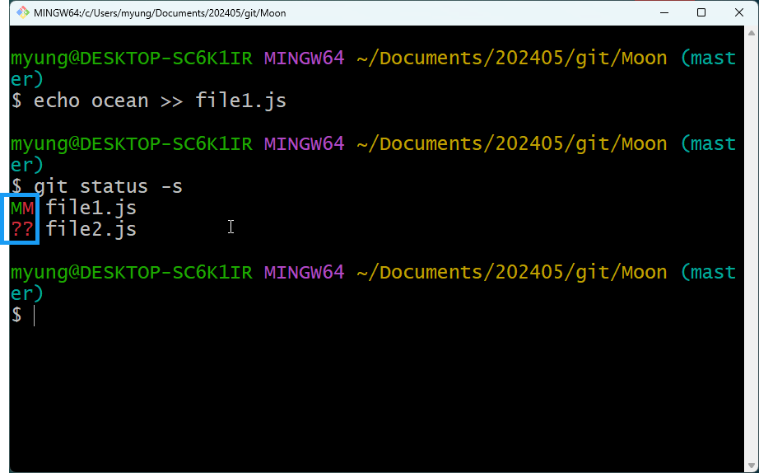
Change file1.js one more time…
Some changes in staging area and also some changes in the working directory

Slide 43
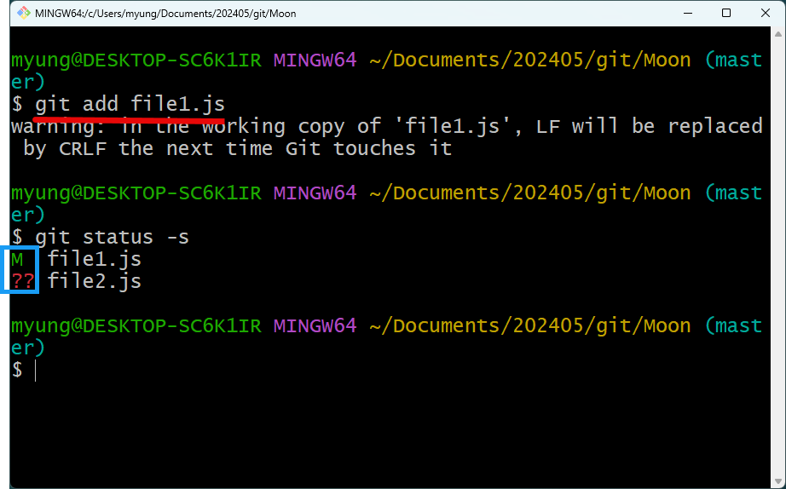

Slide 44
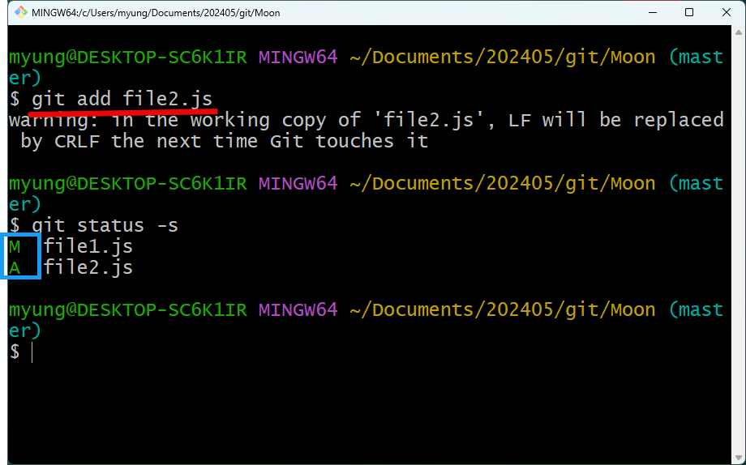
Staging file2.js

Slide 45
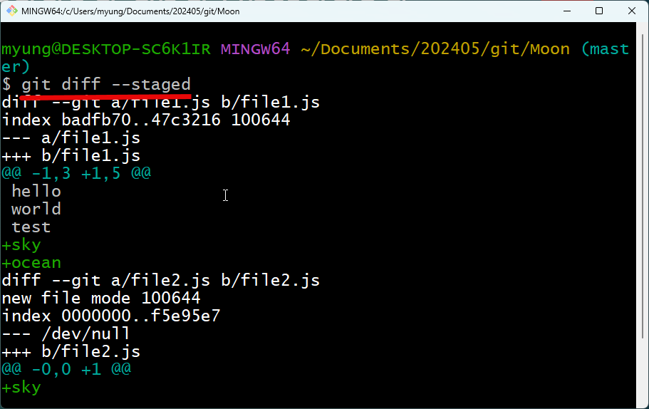
Viewing Staged and Unstaged Changes: diff
‘-’ means old copy
‘+’ means new copy
Line 1 ~ 3: old copy
Line 1 ~ 5: new copy
+sky
+ocean
==> newly added

Slide 46
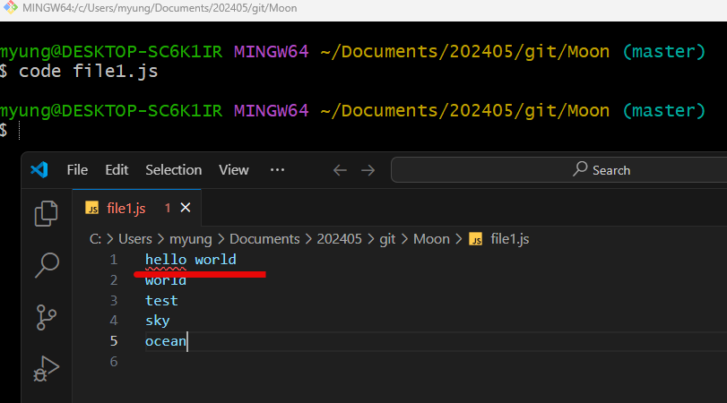
The following command is used to view all changes including the working directory
> git diff
Modify the first line of file1.js using VS Code

Slide 47


Slide 48


Visual DIFF Tools

Slide 49


Slide 50


Slide 51

Viewing History
HEAD references the current branch. So, it references ‘master’ branch.
Author, email, date, and message are logged.
Space bar: next screen.
‘q’ key: exit from the log.

Slide 52


Slide 53

Viewing a Commit

Slide 54



Slide 55


Slide 56



Slide 57

Unstaging Files
Changes in the staging area will revert back to the working directory.

Slide 58

Newly created and staged files will revert to new untracked files.

Slide 59

Discarding Local Changes
Discard all local changes
Newly created untracked files will not be affected because git doesn’t have any information of their previous files.

Slide 60


Slide 61


Slide 62

Restoring a File to an Earlier Version
Delete a file and accidently commit the change.

Slide 63

Restore the file from the previous snapshot and add it a new untracked file.

Slide 64

Creating Snapshots with VS Code
Open the folder using VS Code

Slide 65


Slide 66

Using icons, you can stage and unstage changes.

Slide 67


Slide 68


Slide 69


Slide 70

GitKraken

Slide 71


Slide 72


Slide 73

Summary – Creating Snapshots

Slide 74


Slide 75



Slide 76


Slide 77


Slide 78
Exercises
1. Initialize a new repository. Add two files in your working directory.
2. View the status of the working directory and the staging area.
3. Stage both files.
4. View the changes in the staging area.
5. Create a commit.
6. View the list of commits.
7. View the content of the last commit.
8. Update one of the files. View the changes in the working directory.
9. Stage the changes.
10. Unstage the file.

